Slide 1

OPC UA application
About, flow and demo
Yurii Shchehliuk

Slide 2
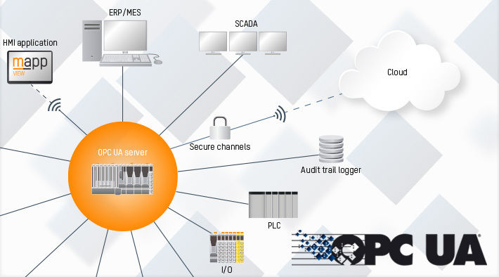
About OPC UA
OPC UA, developed by the OPC Foundation, serves as a standard for transmitting data from sensors to cloud-based applications.
This open-source, cross-platform framework consolidates the features of individual OPC Classic standards into one extensible framework.
It supports both client-server and publish-subscribe communication models and offers a range of security protocols and profiles.

Slide 3
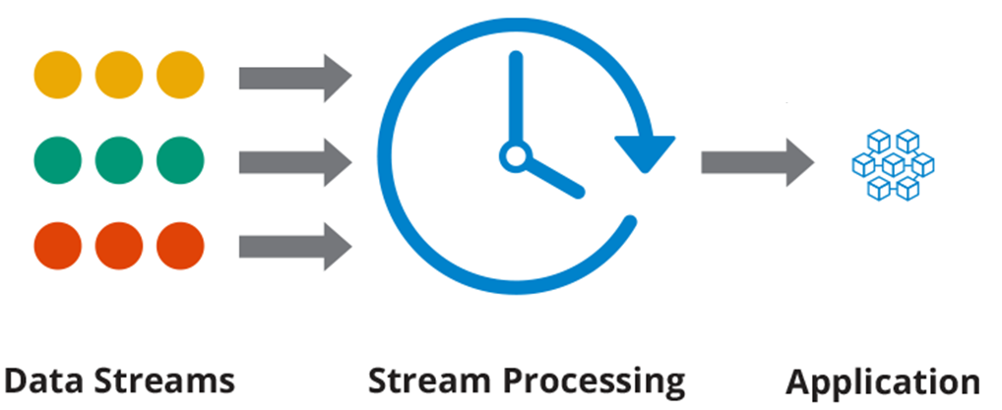
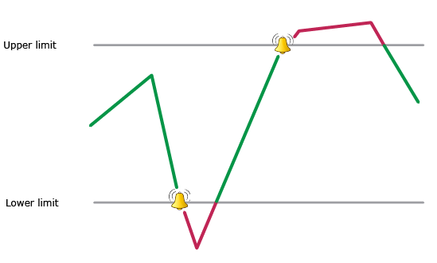

OPC UA main benefits
While CSV exports or database dumps provide a snapshot of data at a given point in time, OPC UA allows for real-time data access and monitoring.
OPC UA offers advanced mechanisms for handling alarms and events, ensuring operators are immediately informed of any critical issues.
While there might be costs associated with setting up OPC UA initially, it can be more cost-effective in the long run than maintaining and updating multiple vendor-specific interfaces.

Slide 4
Flow compare
Traditional approach
Vendor Machine == hardware + sensors
⬇
Machine Controller == Data Processing + Validate/Normalize Data
⬇
Vendor data processing
⬇
Write data to DB or CSV
⬇
Consume CSV or DB data
⬇
QIAGEN
OPC UA approach
Hardware
⬇
Sensor (e.g., "pressure sensor") + Data Capture
⬇
Machine Controller == Data Processing + Validate/Normalize Data
⬇
OPC UA Server == Data Exposure (Standardized for OPC UA) + Security (Encryption, Auth, etc.)
⬇
OPC UA Client == Data Retrieval (Configurable by QIAGEN) + Filter/Select Data of Interest
⬇
HMI (Human-Machine Interface) = data visualization

Slide 5
Traditional approach
Vendor Machine == hardware + sensors
⬇
Machine Controller == Data Processing + Validate/Normalize Data
⬇
Vendor data processing
⬇
Write data to DB or CSV
⬇
Consume CSV or DB data
⬇
QIAGEN
Vendor Machine: The machinery or equipment that generates and holds the data.
Vendor's Data Processing: The vendor processes the machine data to make it suitable for storage. This could involve data validation, filtering, or any necessary transformations.
Write Data: This is the process by which the processed data is written to an external storage system.
Database or CSV: External storage where the data is kept. Databases allow for structured storage and query capabilities, whereas CSVs provide a more portable but less query-friendly storage solution.
QIAGEN: Consumes or uses the stored data for analytics, monitoring, or other operational needs.

Slide 6
OPC UA approach
Machine Controller: Acts as the brain of the hardware. It processes and manages data from the sensors and might also control machine operations based on this data.
Data Processing: Conversion and organization of raw sensor data into a more structured and usable format.
OPC UA Server: This is where the processed data is exposed in a standardized format for external systems to access.
Data Exposure: The server makes data available, ensuring it's in the right format, and applying any necessary security measures like encryption or authentication.
OPC UA Client: A software component, possibly at QIAGEN's end, which connects to the OPC UA server to fetch the exposed data.
Data Retrieval: The client can be configured to select specific data points of interest, ensuring only relevant data is fetched.
HMI (Human-Machine Interface): The interface through which operators or users can view and possibly interact with the machine data.
Hardware
⬇
Sensor (e.g., "pressure sensor") + Data Capture
⬇
Machine Controller == Data Processing + Validate/Normalize Data
⬇
OPC UA Server == Data Exposure (Standardized for OPC UA) + Security (Encryption, Auth, etc.)
⬇
OPC UA Client == Data Retrieval (Configurable by QIAGEN) + Filter/Select Data of Interest
⬇
HMI (Human-Machine Interface) = data visualization

Slide 7
Flow compare
Traditional approach
Vendor Machine == hardware + sensors
⬇
Machine Controller == Data Processing + Validate/Normalize Data
⬇
Vendor data processing
⬇
Write data to DB or CSV
⬇
Consume CSV or DB data
⬇
QIAGEN
OPC UA approach
Hardware
⬇
Sensor (e.g., "pressure sensor") + Data Capture
⬇
Machine Controller == Data Processing + Validate/Normalize Data
⬇
OPC UA Server == Data Exposure (Standardized for OPC UA) + Security (Encryption, Auth, etc.)
⬇
OPC UA Client == Data Retrieval (Configurable by QIAGEN) + Filter/Select Data of Interest
⬇
HMI (Human-Machine Interface) = data visualization

Slide 8
Traditional Approach vs. OPC UA Approach:
Dataflow & access:
Traditional: Data generated by the vendor machine is processed and stored in an external storage (like a Database or CSV). QIAGEN, or any other interested party, retrieves the data from this storage.
OPC UA: The data, straight from the sensors and machine controllers, is processed and directly exposed to external systems via an OPC UA server in real time. QIAGEN can instantly access this data through an OPC UA client.
Timeliness:
Traditional: Data access might not be in real-time. There could be a delay due to the data processing, storage, and retrieval processes.
OPC UA: Offers near real-time access to the data since there are no intermediate storage steps.
Flexibility:
Traditional: Bound to the data processing and storage solutions of the vendor. If the vendor writes data to a CSV or DB in a particular way, QIAGEN must adapt to that format and structure.
OPC UA: QIAGEN has more control. The OPC UA client can be configured to fetch only data that are of interest, and since OPC UA is a standard, the data representation is consistent across various machines.
Security:
Traditional: Security depends on the storage solution. A database might have its security features, but a CSV file might be more vulnerable.
OPC UA: Built-in security features, including encryption, authentication, and authorization, ensuring data integrity and protection against unauthorized access.

Slide 9
Traditional Approach vs. OPC UA Approach:
Integration & Scalability:
Traditional: Each new vendor or machine might require a new integration process, especially if they have different data processing or storage methods.
OPC UA: Scalability is easier. Since OPC UA is a standard, adding new machines or sensors is more straightforward, with fewer integration challenges.
Dependency:
Traditional: Reliance on the vendor's method of data processing and storage. If the vendor decides to change their methods, it could require adjustments on QIAGEN's end.
OPC UA: Reduced dependency on the vendor's specific methods. As long as they support OPC UA, the data can be accessed consistently.
Future-Proofing:
Traditional: Relying on vendor-specific solutions might not be future-proof. If the industry moves towards new standards or technologies, the traditional method might become outdated.
OPC UA: Being a globally recognized and supported standard, OPC UA ensures that the setup remains relevant even as technology evolves.
Cost & Implementation:
Traditional: Might be more cost-intensive in the long run due to potential repeated integration efforts. Any change or update could lead to additional costs.
OPC UA: Initial setup might involve costs, but future integrations or modifications might be more cost-effective due to the standardization.

Slide 10
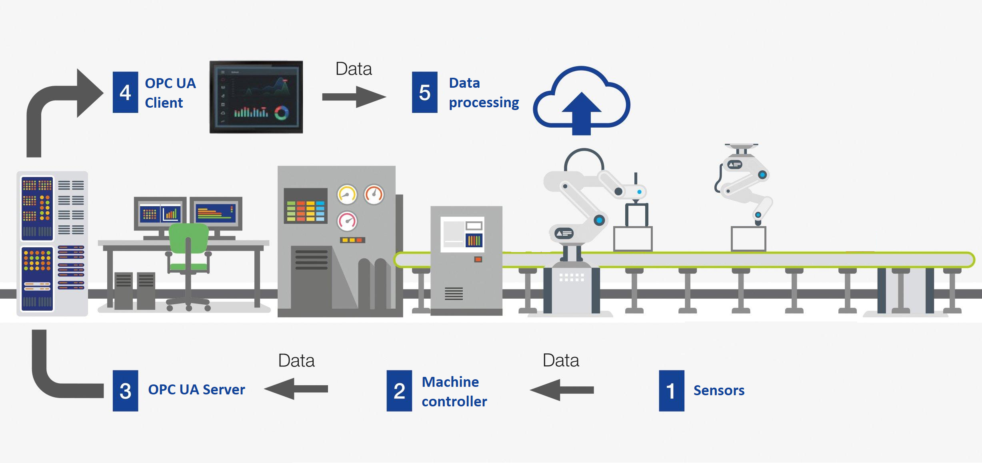
Summary
The traditional approach involves multiple steps and intermediaries, potentially leading to:
• delays • increased costs • reduced flexibility
The OPC UA approach offers a more direct, scalable, and standardized method for:
• data access • provide real-time insights • reducing dependencies on vendor-specific solutions
In the Traditional method, data flows through the vendor's data processing system and into a database or CSV storage before reaching QIAGEN.
In the OPC UA approach, data flows directly from the hardware sensors through the machine controller to the OPC UA Server, from where it's fetched by the OPC UA Client and displayed on the HMI. This direct flow in the OPC UA approach often provides more timely and flexible access to the data compared to the traditional method.

